Slide 1

Trends in Technology for Translators: Deep Learning and Automatic Translation
Dr Sai-cheong SIU
Director, Deep Learning Application and Research Centre
The Hang Seng University of Hong Kong

Slide 2
Deep Learning Research and Application Centre
The Hang Seng University of Hong Kong

Slide 3
Artificial Intelligence
Machine Learning
Symbolic AI
Deep Learning
Many others (e.g., SVM, Decision tree, k-NN)

Slide 4
Deep Learning
AlphaGo
Speech
recognition
Sentiment analysis
Summarization
Chatbot
Stock price prediction
Image classification
Object detection
Self-driving cars and many more

Slide 5
Deep Learning Research and Application Centre
Funding of HK$6.8 million
Hardware: Graphics processing unit (GPU)-accelerated hardware for much faster training and decoding
Software: PyTorch, Tensorflow, Keras, Transformer…
Projects involving deep neural networks

Slide 6
Projects (https://dlc.hsu.edu.hk/)
Machine translation (e.g., automatic translation of listing documents; recent funding: HK$1.4 million)
Smart retail
English proofreading
Weather analysis, forecast and communication
Detection of fake news
Financial analysis

Slide 7
Trends in Technology for Translators

Slide 8
Outline
Useful Tools for Professional Translators
AI and Translation Technology
Ways to Make Better Use of Automatic Translation Systems

Slide 9
Outline
Useful Tools for Professional Translators
AI and Translation Technology
Ways to Make Better Use of Automatic Translation Systems

Slide 10
Translation Technology
Electronic Dictionaries
Corpora and Concordancers
Translation Databases
Automatic Translation

Slide 11
Electronic Dictionaries
General Dictionaries
Specialised Dictionaries

Slide 12
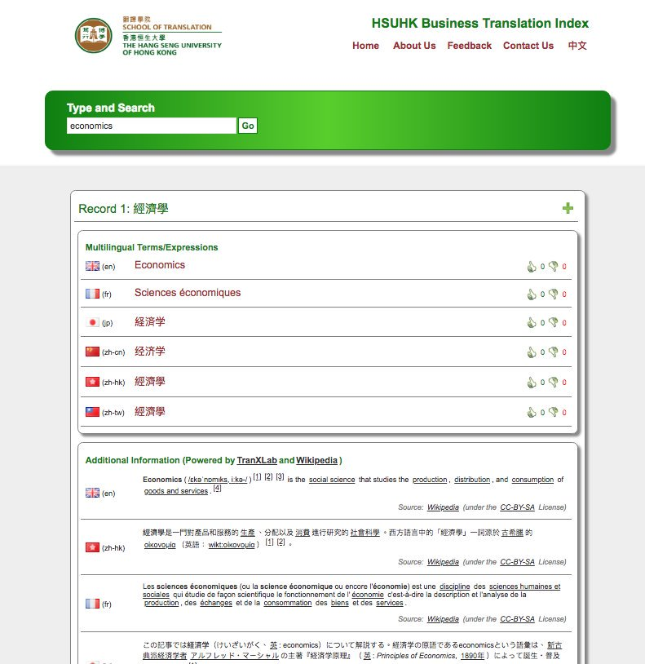
Example: HSUHK Business Translation Index
http://www.hsuhkbti.com/SearchBTI?search=technical+analysis

Slide 13
Corpora and Concordancers
ST Analysis
TL Expressions
TT Analysis
Corpus: Electronic Texts
Expression
Concordancers
Examples/
Statistics

Slide 14
Example 1: Legal Corpus
http://legalcorpus.weebly.com/

Slide 15
Example 2: Ngram Viewer
https://books.google.com/ngrams

Slide 16
Translation Databases: Translation Memories and Termbases
Reuse of TL Sentences
Translation Memories: Previous TT
Terminology Databases:
Multilingual Terms
Consistent Terminology
Quality Control

Slide 17
Example: Memsource
https://www.memsource.com/

Slide 18
Automatic Translation
ST Comprehension
Text Translation
TT Draft
TT Revision
Speech Translation

Slide 19
Outline
Useful Tools for Professional Translators
AI and Translation Technology
Ways to Make Better Use of Automatic Translation Systems

Slide 20
Methods
Rule-based Approach
Example-based Approach
Statistical Approach
Deep Learning Approach

Slide 21
Traditional Approaches to Machine Translation
01
I go to school by train.
我／去／學校／乘／火車／。
我乘火車去學校。
Rule-based Machine Translation
02
I go to school by train.
I go to school by taxi. 我乘計程車去學校。
我乘火車去學校。
Example-based Machine Translation
03
Translation Model
P(“I”|“我”) x P(“go”|“去”) x ...
Language Model:
P(“我乘火車去學校”)
Statistical Machine Translation

Slide 22
Methods
Rule-based Approach
Example-based Approach
Statistical Approach
Deep Learning Approach

Slide 23
Rule-based Machine Translation (RBMT)
Direct MT
Transfer MT

Slide 24
Direct MT
This is considered to be the first generation of MT systems.
The ST is treated as a string of words. The SL words are then replaced by TL words, and the TL words are reordered.

Slide 25
Direct MT
ST
1. Segmentation
2. Tokenization
3. Lemmatization
4. POS-tagging
5. Replacement
6. Modification: Reordering / Addition /
Omission
TT

Slide 26
Segmentation
the process of splitting a text into sentences
Tom was a student. He went to school by bus. He played football with them.
Tom was a student.
He went to school by bus.
He played football with them.

Slide 27
Tokenization
the process of dividing a text into words
He played football with them.
He
played
football
with
them
.

Slide 28
Lemmatization
the process of grouping the identical, related or inflected forms of a word together as a single item (lemma)
Example: do, does, doing, did → do

Slide 29
POS-tagging
the process of assigning a part-of-speech (POS) to every lexical item in the input
He
play(ed)
football
with
them
Pronoun
Preposition
Noun
Verb

Slide 30
Replacement
the process of replacing the SL words with TL words
He (pronoun)
play(ed) (verb)
football (noun)
with (prep)
them
(pronoun)
他
（代名詞）
踢
（動詞）
足球 （名詞）
跟
（介詞）
他們
（代名詞）

Slide 31
Reordering and Modification
the process of reordering the TL words and polishing the TT
他
（代名詞）
踢
（動詞）
足球 （名詞）
與
（介詞）
他們
（代名詞）
他
（代名詞）
跟
（介詞）
他們
（代名詞）
踢
（動詞）
足球 （名詞）

Slide 32
Transfer MT
The basic idea: Analysis, Transfer and Generation
Input sentences are analyzed and translated into an abstract internal representation retaining their features in the SL.
The representation is transferred to a representation with the features in TL and generates the TT.

Slide 33
Transfer MT
ST
1. Segmentation
2. Tokenization
3. Lemmatization
4. POS-tagging
5. Parsing
6. Transfer
7. Generation
TT

Slide 34
Parsing
the process of analyzing the input and generating the SL representation (e.g., a parse tree) that identifies the function of each word/word group

Slide 35
Transfer
the conversion of the SL representation into its equivalent TL representation

Slide 36
Generation
the production of the TL text from the TL representation

Slide 37
An Example
ST: The boy went to Didneyland.
Case conversion: the boy went to didneyland.
Segmentation
<1> the boy went to didneyland.

Slide 38
An Example
Tokenization
<1> the
<2> boy
<3> went
<4> to
<5> didneyland
<6> .

Slide 39
An Example
Lemmatization
<1> the
<2> boy
<3> go (past tense)
<4> to
<5> didneyland
<6> .

Slide 40
An Example
POS-tagging
<1> the (definite article)
<2> boy (noun, singular)
<3> go (verb, past tense)
<4> to (preposition)
<5> didneyland (noun, singular)
<6> .

Slide 41
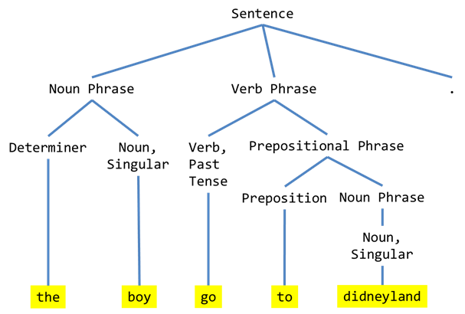
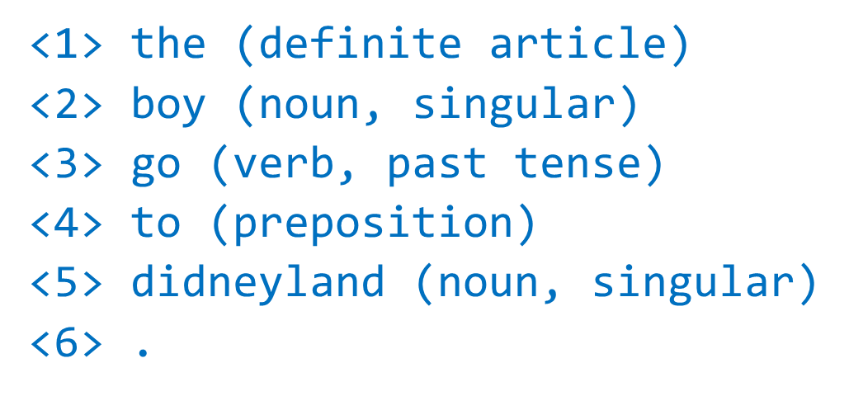
An Example
Parsing

Slide 42
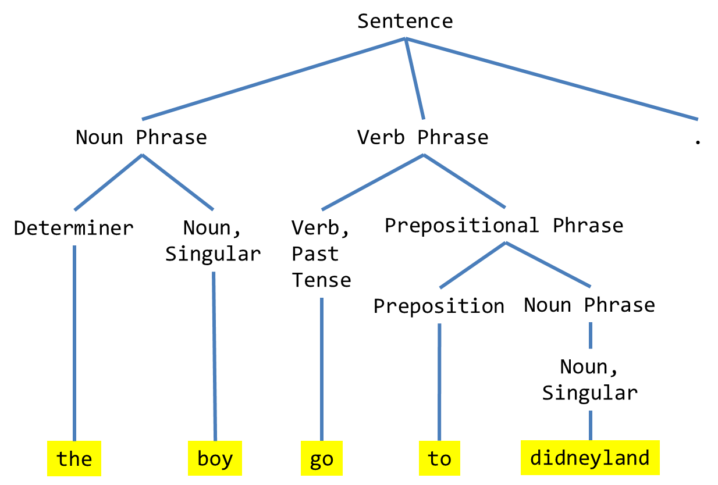
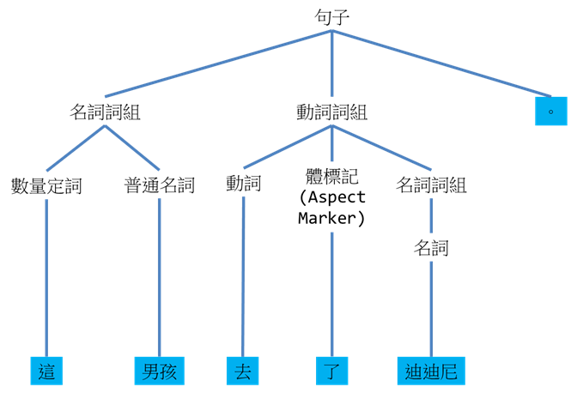
An Example
Transfer

Slide 43

An Example
Generation
這男孩去了迪迪尼。

Slide 44
Methods
Rule-based Approach
Example-based Approach
Statistical Approach
Deep Learning Approach

Slide 45
Finding appropriate translation examples
Reordering the examples retrieved with the assistance of a language model

Slide 46
The best example?

Slide 48
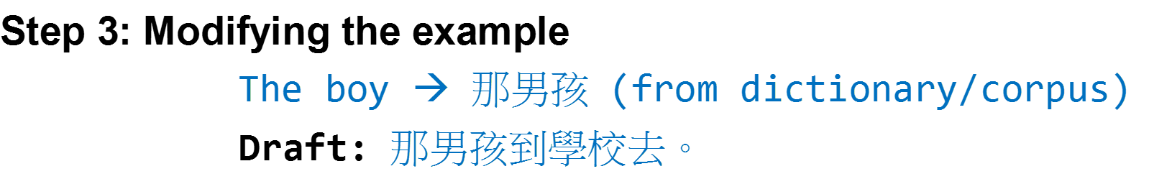
1. Dictionary/Rules:
The → 那
Boy → 男孩
2. Other examples
in the database:
A. By comparison
The boy is naughty.
那男孩真頑皮。
He didn’t see the boy.
他看不見那男孩。
B. By Word Alignment
The/boy/is/tall.
→ 那/男孩/長得/高。
3.
Translation Model:
P(The|那),
P(The|該),
P(boy|男孩),
P(boy|百厭星)…
4.
Hybrid Approach:
1 + 2 + 3

Slide 49
Methods
Rule-based Approach
Example-based Approach
Statistical Approach
Deep Learning Approach

Slide 50
Statistical Machine Translation
Stage 1: Training
A Bilingual Database with Probabilities
A Monolingual Database of TL Expressions with Probabilities
Find expressions that are most likely to be used in the translation
Find the TL word order that is most likely to be correct
ST
TT
Stage 2: Decoding

Slide 51
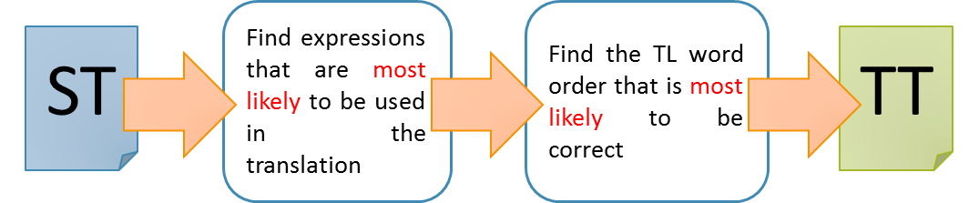
Translation Model
Language Model

Slide 52
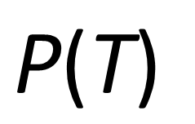
Language Model
Do you prefer fish ?
Elephants love her .
Give me fish .
Dogs love swimming .
We love dogs .
$$\text{P}\text{(}\text{T}\text{)}$$
Monolingual Corpus in the Target Language

Slide 53
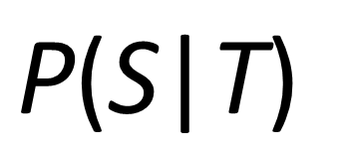
Translation Model
Source Language
我喜歡貓 。大象鍾意我 。人們喜歡狗 。他們嗜魚 。我們喜歡猴子 。你喜歡豬 。
Target Language
I love cats. Elephants love me. People love dogs. They prefer fish. We love monkeys. You prefer pigs.
$$\text{P}\text{(}\text{S}\text{|}\text{T}\text{)}$$
Bilingual Corpus

Slide 54
Monolingual (in TL)
Bilingual
Data
Tables

Slide 55
Dogs love elephants.
Dogs elephants love.
Love dogs elephants.
Love elephants dogs.
Elephants love dogs.
Elephants dogs love.
Dogs loves elephants.
Dogs elephants loves.
Loves dogs elephants.
Loves elephants dogs.
Elephants loves dogs.
Elephants dogs loves.
User’s Input
MT Output
狗喜歡大象。
Dogs love elephants.
Bilingual Table
Monolingual Table

Slide 56
Methods
Rule-based Approach
Example-based Approach
Statistical Approach
Deep Learning Approach

Slide 57
Biological Neuron
dendrite
樹突
axon terminal
軸突末端／終末
soma
細胞體
2
activation
“input”
from
other
neurons
axon 軸突
“output” to
other
neurons
1
3
nucleus
細胞核

Slide 58
Biological Neural Network
…
…

Slide 59
Artificial Neuron
Input
1
Example: Adding (input value x weight)
Example: If the sum of the input > 0, the output = 1.
weight = 0.5
Output
0
weight = 0.2
Activation Function
1
Sum
(~soma)
(~axon)
weight = 0.3
Ans: 0.8
1
(~dendrites)

Slide 60
Artificial Neural Network: Many Neurons

Slide 61
Deep Learning: Multiple Hidden Layers
Input
Hidden
Output

Slide 62
Automatic Translation as a Prediction Problem: Given X, what is the next word?
Given the following:
ST: I / go / to / school / by / bus / . /
TT: 我 / 乘
Which of the following is most likely to be the next word?
公車
火車
學校
咖啡
電腦
翻譯

Slide 63
Deep Learning and Automatic Translation
Given [I] / [go] / [to] / [school] / [by] / [train] / [.], what is the next word?
我
[I] / [go] / [to] / [school] / [by] / [train] / [.] / [我] ⇒ ?
乘
[I] / [go] / [to] / [school] / [by] / [train] / [.] / [我] / [乘] ⇒ ?
火車
[I] / [go] / [to] / [school] / [by] / [train] / [.] / [我] / [乘] / [公車] ⇒ ?
去
[I] / [go] / [to] / [school] / [by] / [train] / [.] / [我] / [乘] / [公車] / [去] ⇒ ?
學校
[I] / [go] / [to] / [school] / [by] / [train] / [.] / [我] / [乘] / [公車] / [去] / [學校] / ⇒ ?
。
Translation: 我乘火車去學校。

Slide 64
Outline
Useful Tools for Professional Translators
AI and Translation Technology
Ways to Make Better Use of Automatic Translation Systems

Slide 65
Be a Smart User!
Domain-specific Systems
Multiple Systems
Customizable Systems

Slide 66
Domain-specific Systems
Example: Our Project
Machine Translation of IPO Documents
General Documents
Deep Neural Networks
IPO Documents

Slide 67
Multiple Systems
Qtranslate: http://quest-app.appspot.com/home
ImTranslator: http://imtranslator.net/compare/

Slide 68
Customizable Systems
Our Prototype (https://customizemt.000webhostapp.com/)

Slide 69
Making MT More Useful
Automatic Segmentation
Customizable Translation Database
Key Expression Identification
Instant Search

Slide 70
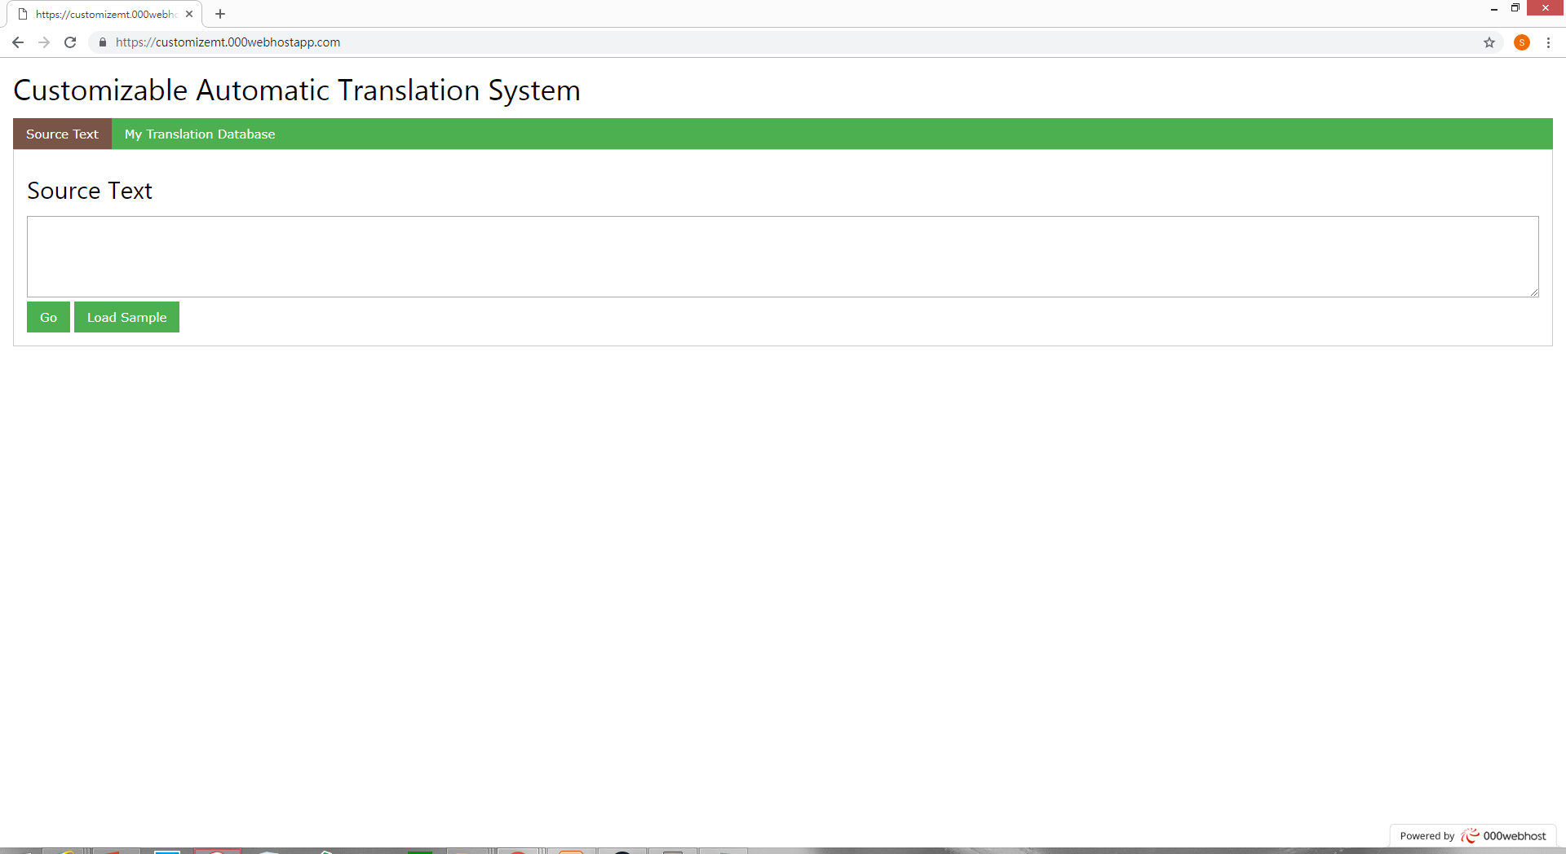

Slide 71
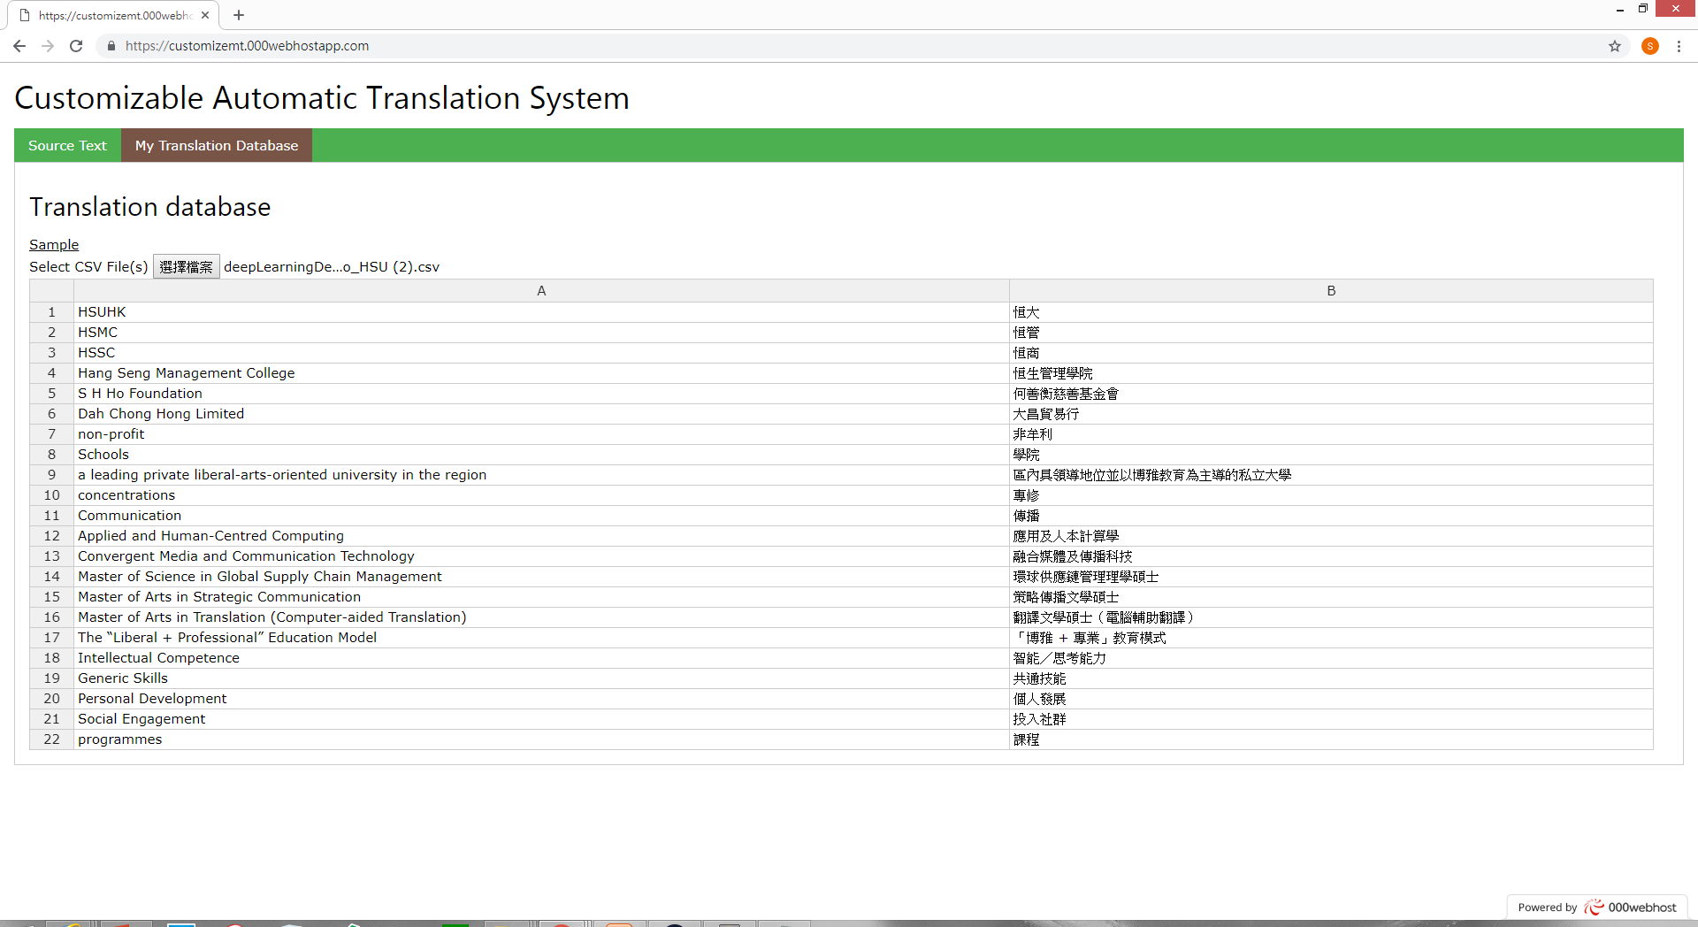

Slide 72
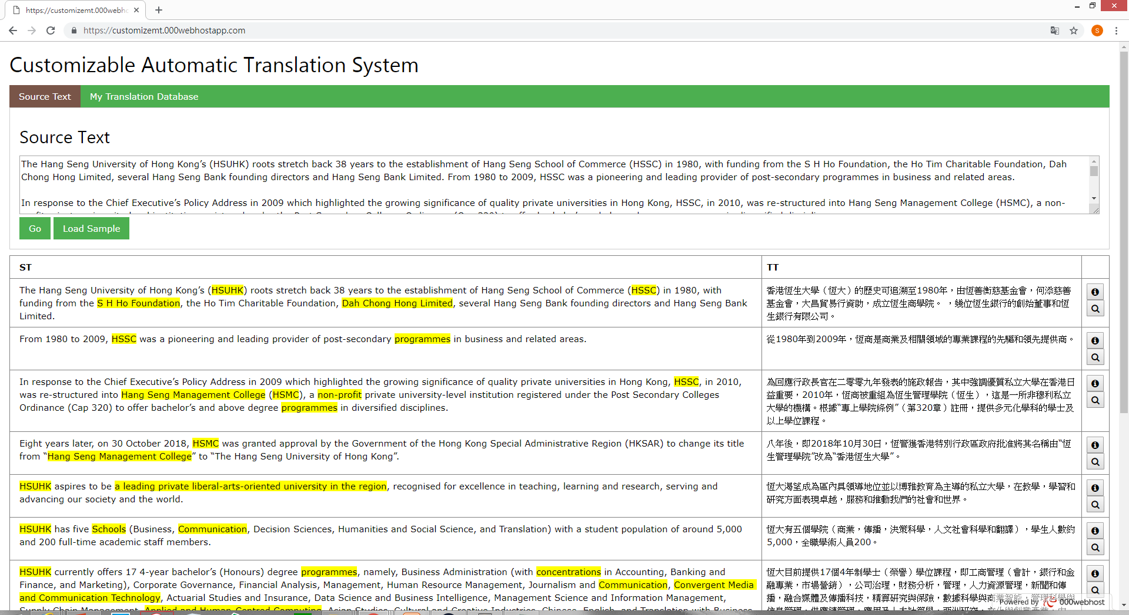

Slide 73
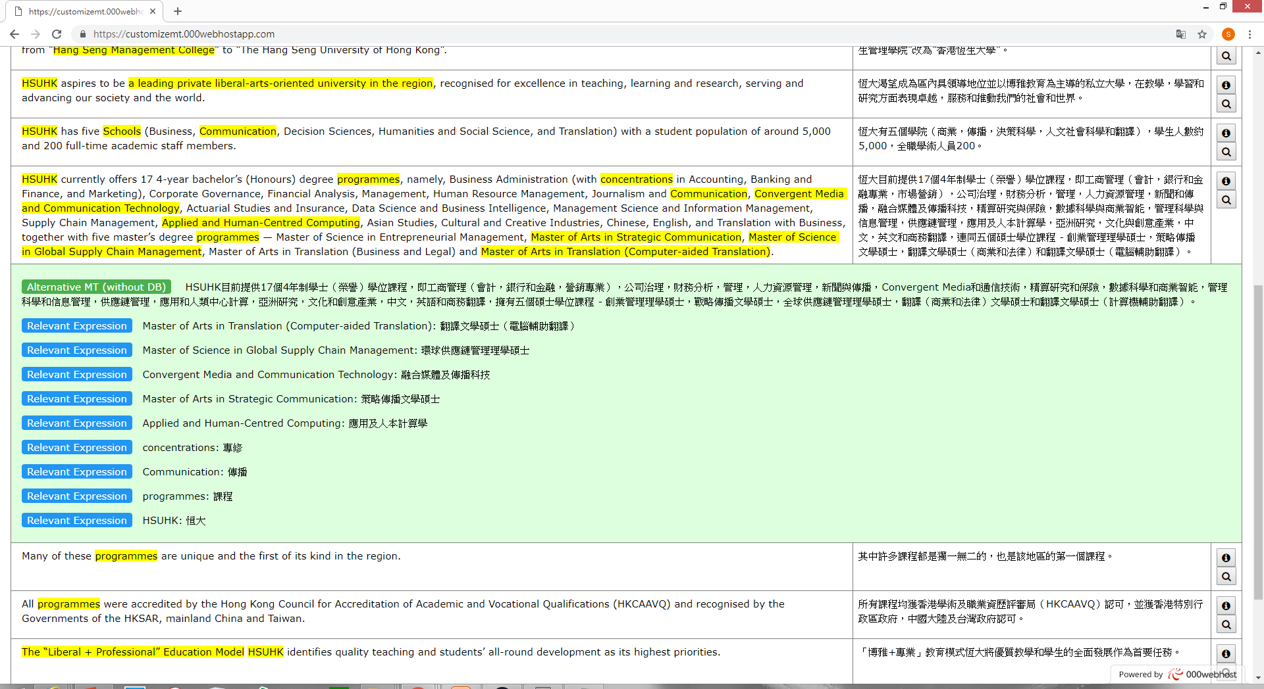

Slide 74
Many other tools
Tools for Medical Translation
Tools for Translation of Government Documents
Tools for Scientific Translation
Tools for Translation of Philosophical Texts
Tools for Interpreting
Tools for Subtitling
Tools for Web Translation
Tools for Bilingual Digital Marketing
Tools for Team Translation / Project Management

Slide 75
Short Courses
MA in Translation

Slide 76
Other Research Projects
Prototype: IPO prospectus
MT-CAT Integration (with multiple translation suggestions?)
Computer-aided Interpreting

Slide 77
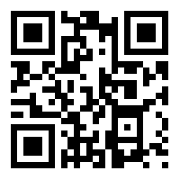
Thank you very much!
Email: scsiu@hsu.edu.hk
Website: https://www.hsuhk-translation-technology.com
More Workshops:
Our Facebook
https://goo.gl/M9rHs5

